Slide 1

Programming presentation
MEC 2022

Slide 2

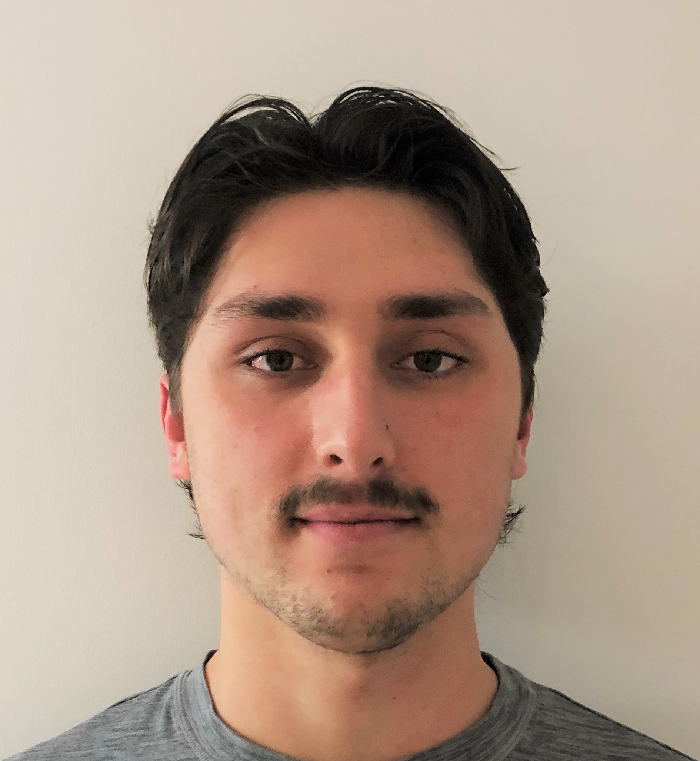



OUR Team
Raphaël Fontaine
S. Nicolas Dolgopolyy
Alondra Karam
Selen Demirli

Slide 3
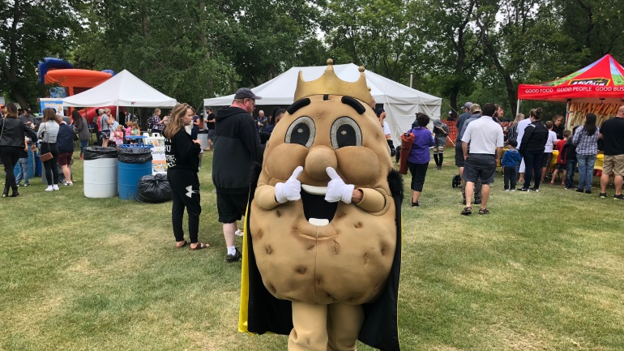

tHE PROBLEM
POTATO CLOUD FEST

Slide 4

Challenges addressed
AI
Debugging
DevOps
Web
Software Engineering Questions

Slide 5
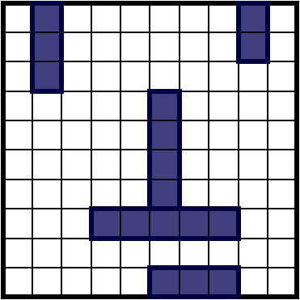
AI
Probabilistic approach based on open space
Point-based board matrix

Slide 6
Software Q1
Question 1
a) Which of the following options best describes the TDD rules?
Option B
b) What is the difference between a unit test and an integration test? Can these types of tests be considered regression tests? Why?
Unit testing is like white box testing where it is straightforward. You test small modules as you write your code. Integration testing is more complex, it is known as black box testing where you test two or more programs together. This makes it slower and difficult to run and find errors. Regression testing is just going back after you've added code and testing to make sure everything still works fine. I wouldn't say that unit testing and integration testing ARE regression tests but rather these tests could be used to perform regression tests.
c) What is Infrastructure as a Service (IaaS), Platform as a Service (PaaS), Software as a Service (SaaS). Give an example for each.
IaaS is a third party that provides cloud storage but the OS and data is all managed by the user. An example of this is google cloud. PaaS allows you to write your code to build your apps/programs without having to deal with the maintenance of the platform. An example of this is Windows Azure. And lastly SaaS is an application service that is fully managed by the provider. This is the case for most applications, an example being Slack.
d) Explain the similarities and differences between Infrastructure-as-Code and Pipeline-as-Code.
Both asCode operations allow for easy collaboration within teams. They also allow for all older versions of code to be accessible so you never lose any previous work you had. The difference between the two is that infrastructure is more known for cloud infrastructures whereas pipeline is like git.
e) As a PotatoFest release engineer, make it clear to your CEO that it would be the best strategy to take among the four strategies.
A/B testing is focused on testing multiple ideas. It tests different experiments in the same environment to provide the best outcome. This way the CEO can really test each which color scheme works best for his application.

Slide 7
Software Q2
Question 2
a) How can we see the changes made in a particular commit?
Use the git show command.
b) Your teammate would like you to look at their branch because one of their tests didn't work, but you were almost done implementing your feature. How can you see your teammate's branch without losing the changes you made?
Commit your changes and then go look at your friend's branch.
c) How to create a local copy of the remote directory https://cqi.git.com/repository.git?
Use the git clone command.
d) How to create a new feature/action branch and go to that branch?
Wherever you would want the new branch, you just click New branch.
e) How to push local changes to remote directory?
Use git push command.
f) You are on the feature/pre-cqi branch. How to bring the changes from the refactor/pre-cqi branch to your branch?
You can use the merge command.

Slide 8
Software Q4
Question 4
a) Based on the Figure, describe the life cycle used for the development of this new software.
This is a disciplined life cycle for example waterfall, because there was much more time spent on implementation than on testing.
b) Based on the lifecycle and data in the Figure, describe potential issues that this new software might have that might concern maintenance.
Since the software was not tested very much, there could be little risk mitigation strategies. If there are issues it will be hard to go back and fix them as this model does not account for changes in the requirements.
c) As the manager of the maintenance team, and based on the problems described above, what would you do to mitigate the maintenance challenges brought by this new software ?
I would switch this project to use a more agile approach. We would discuss and test more often than work on the requirements, in order to quickly resolve the issue an make it easier to go back and make changes.

Slide 9
Software Q5
Question 5
For the following six contexts, say which agile (incremental, transformational) or disciplined (spiral, waterfall) approach would be more appropriate.
a) The configuration of a programmable automaton controlling the transformation of raw ore from iron pellets in a blast furnace.
Disciplined
b) The development of a new on-demand cloud services platform cloud computing) intended to compete with Amazon web services on a global level (Amazon Web Services).
Agile
c) The configuration and adjustment of an existing inventory management software for a small neighborhood business.
Disciplined
d) The development of scripts to convert an existing website to an e-commerce from PHP 5 to PHP 7.
Disciplined
e) Development of software for a new fully autonomous car (driverless car).
Agile
f) A research project whose objective is to develop new smart home software intended to assist elderly people living alone.
Agile
g) Context of software development with several customers who have prospects different from the product to be produced.
Disciplined
h) Context of a project carried out with teams distributed over several sites somewhat around the world.
Disciplined

Slide 10
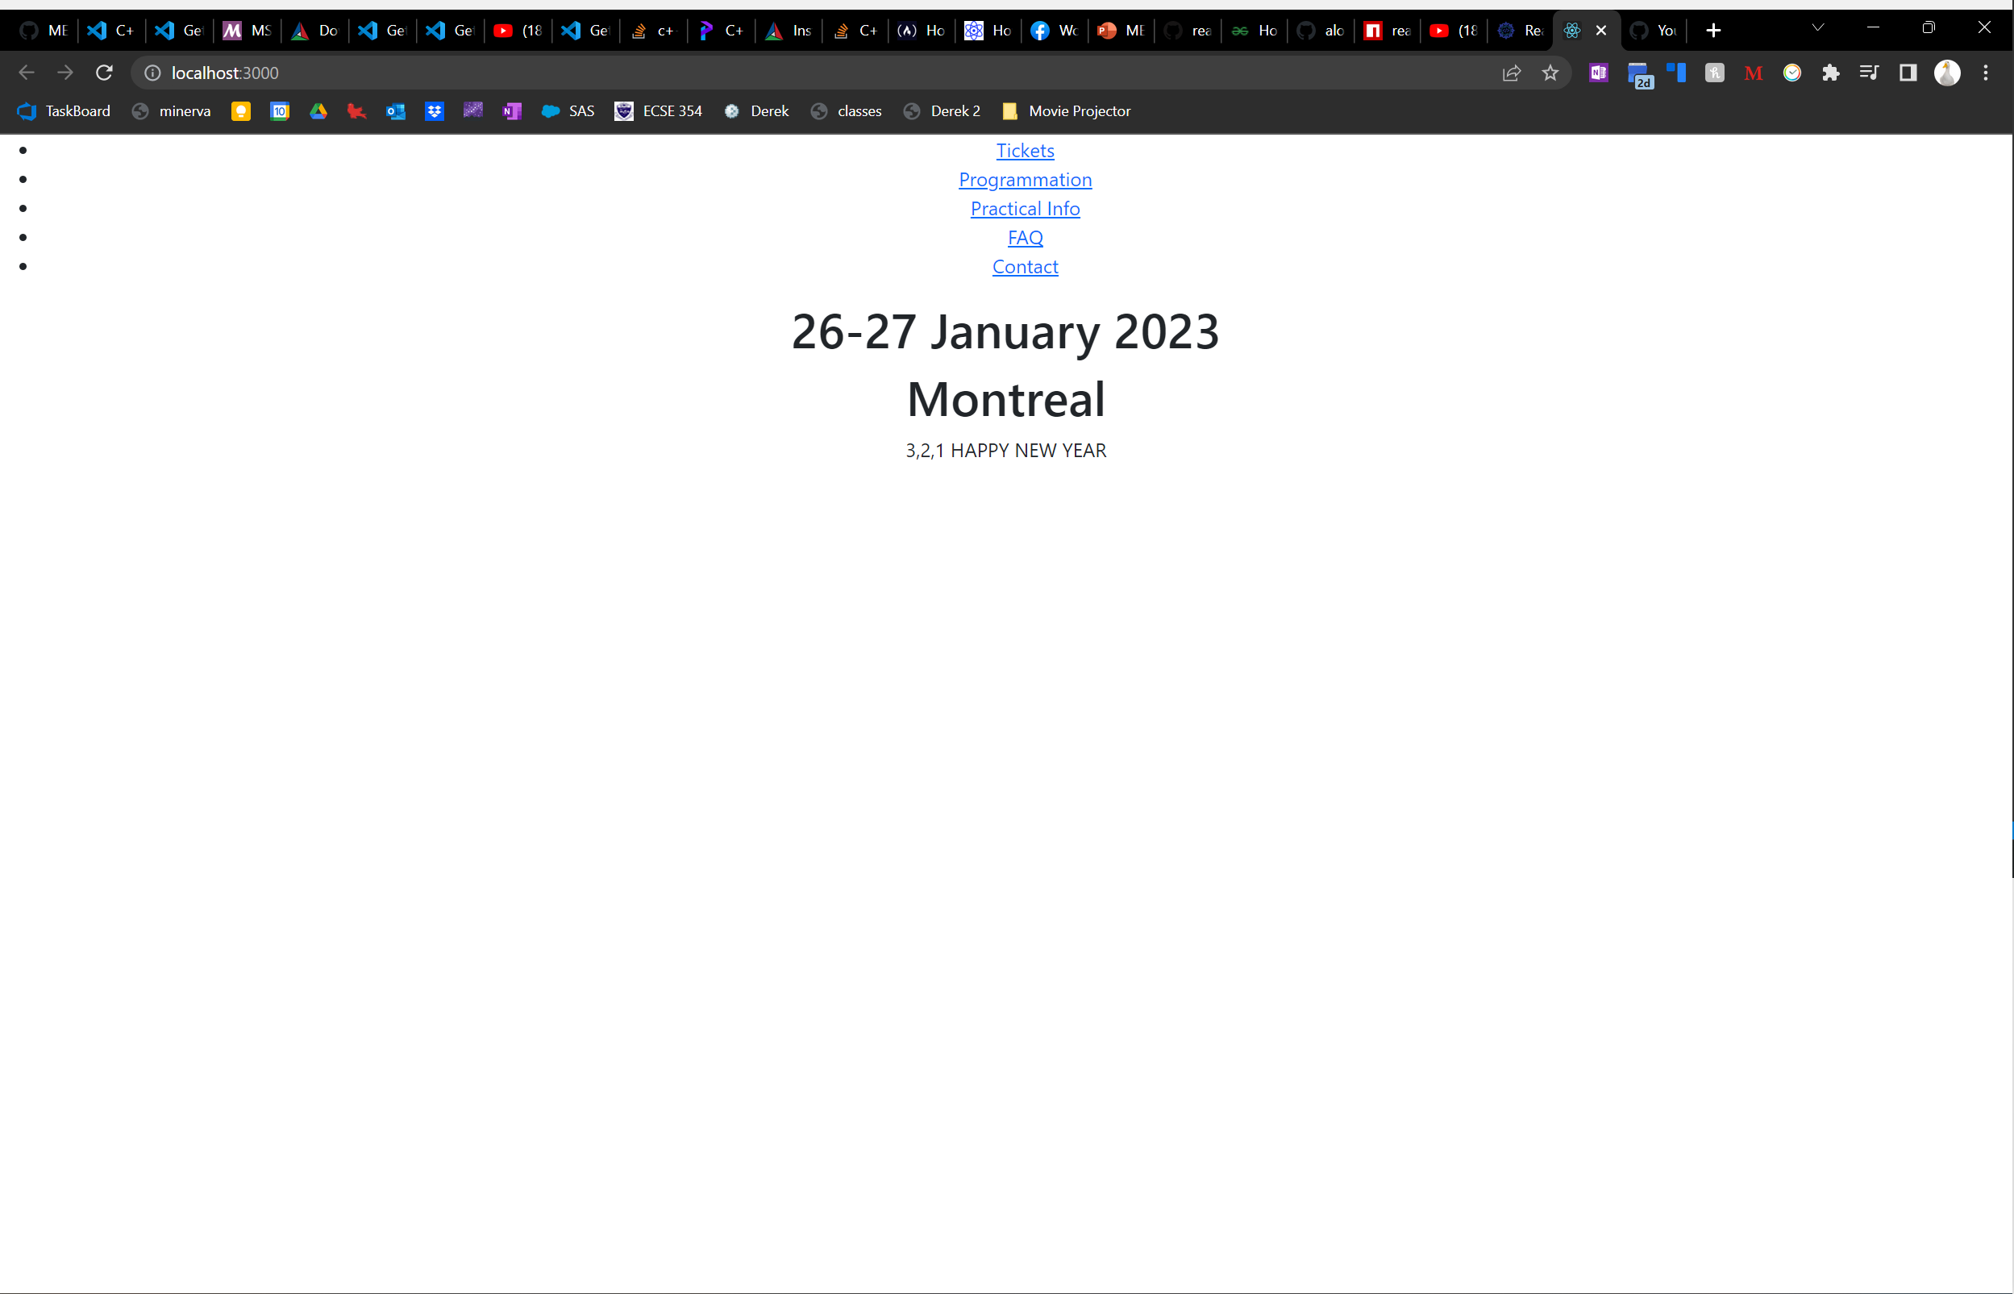
Web
https://fontaine44.github.io/MEC2022/

Slide 11
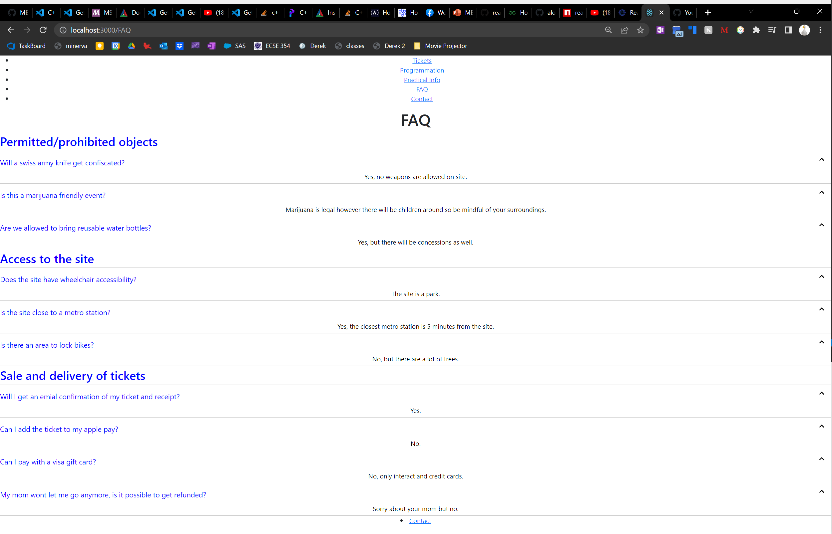
FAQ Page

Slide 12
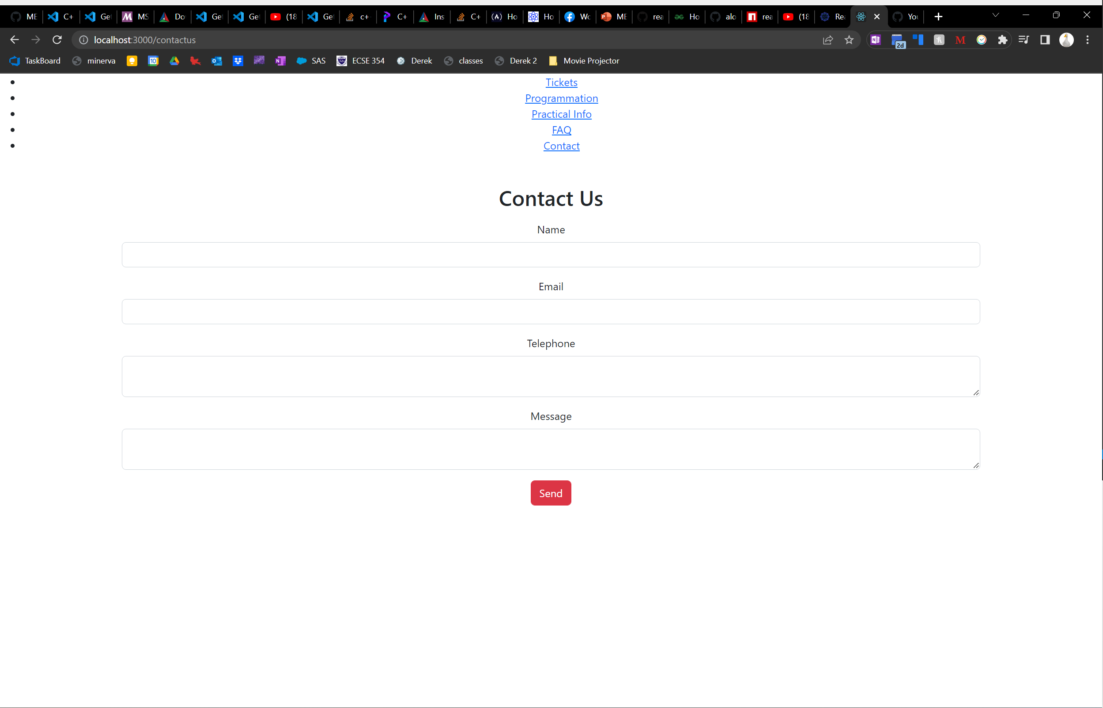
Contact US

Slide 13
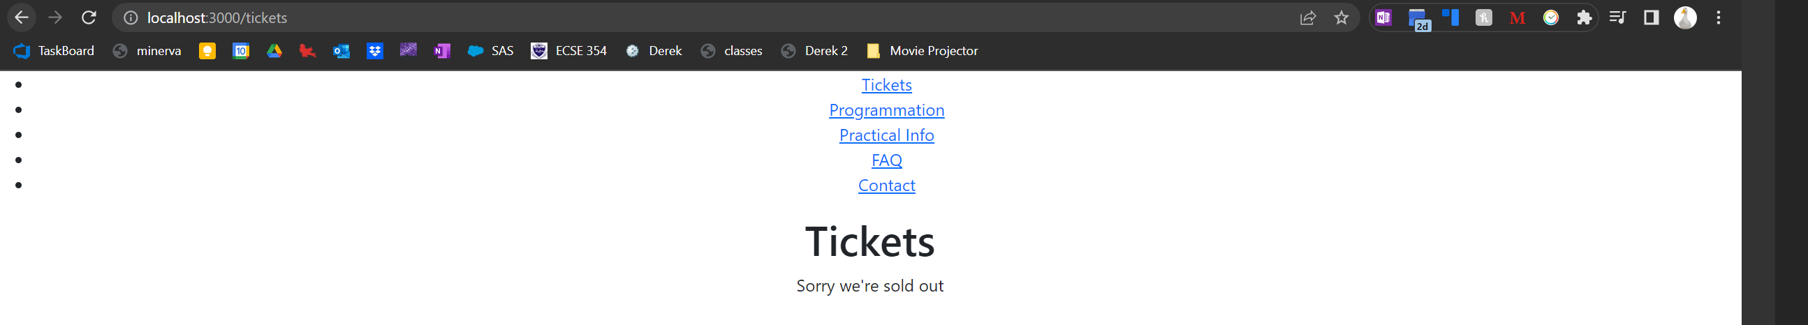
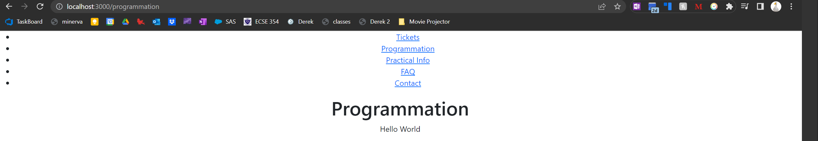
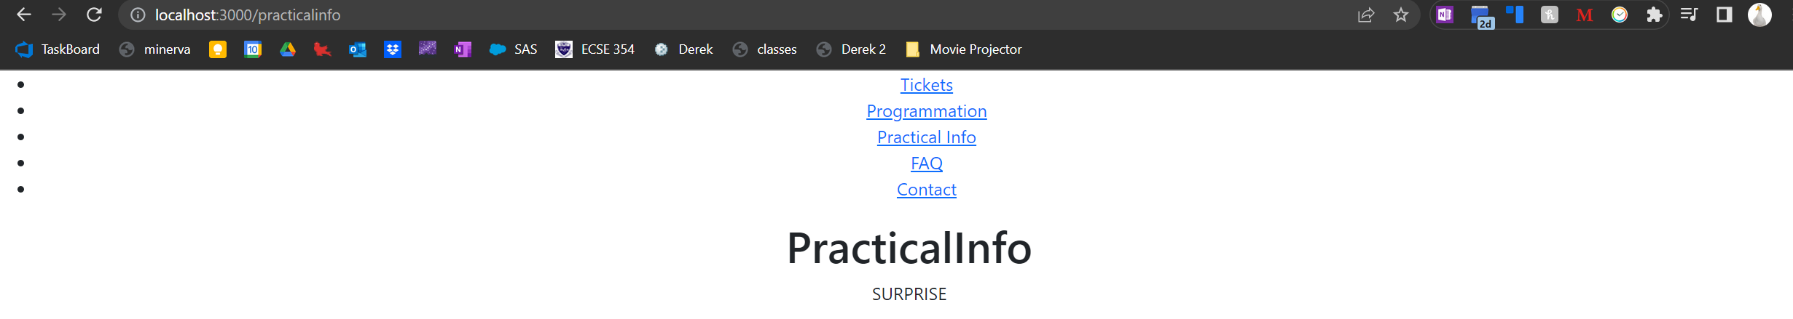
Other Pages

Slide 14
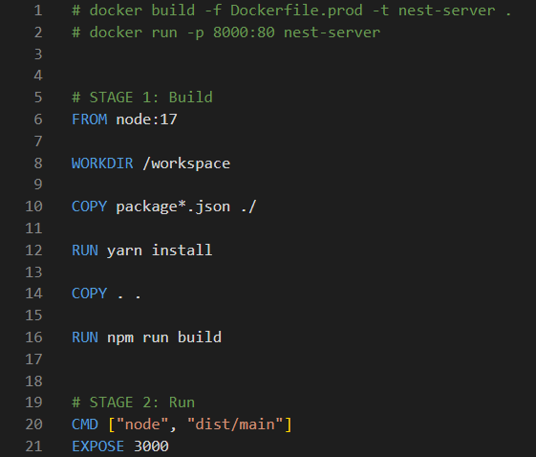
DEVOPS Q1
Complete server/Dockerfile.prod in multi-stage with a build stage and an execution stage.

Slide 15
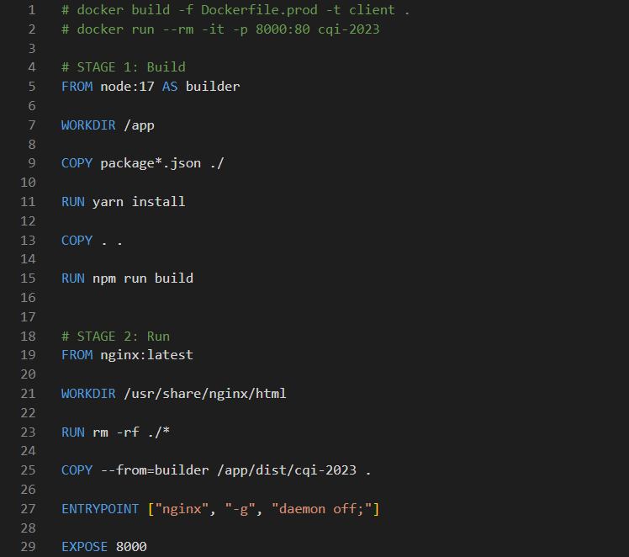
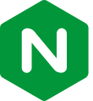
DEVOPS Q2
Complete client/Dockerfile.prod in multi-stage with one build step and one runtime.
NGINX is a free, open-source, high-performance HTTP server and reverse proxy, as well as an IMAP/POP3 proxy server. NGINX is known for its high performance, stability, rich feature set, simple configuration, and low resource consumption.

Slide 16
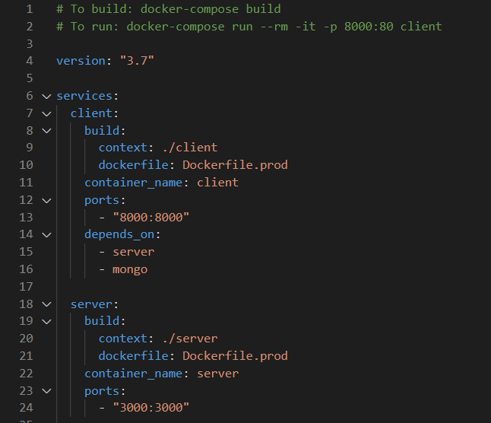
DEVOPS Q3
Complete the docker-compose.yml to create an environment where a client can communicate with the server.

Slide 17
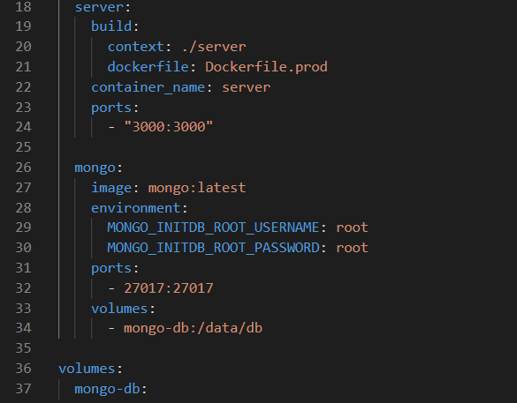
DEVOPS Q4
Add to docker-compose.yml a mongoDB instance so that the server can access it.

Slide 18
Questions?

